Slide 1
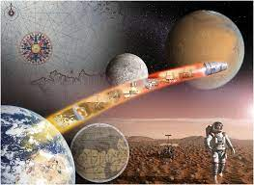
Planetary Tourism
Team Name : Astronauticx
Members :
Shyamal Kacha
Hardik Sherke
Dhairya Patel
Krish Parikh
Kalu Prajapati

Slide 2

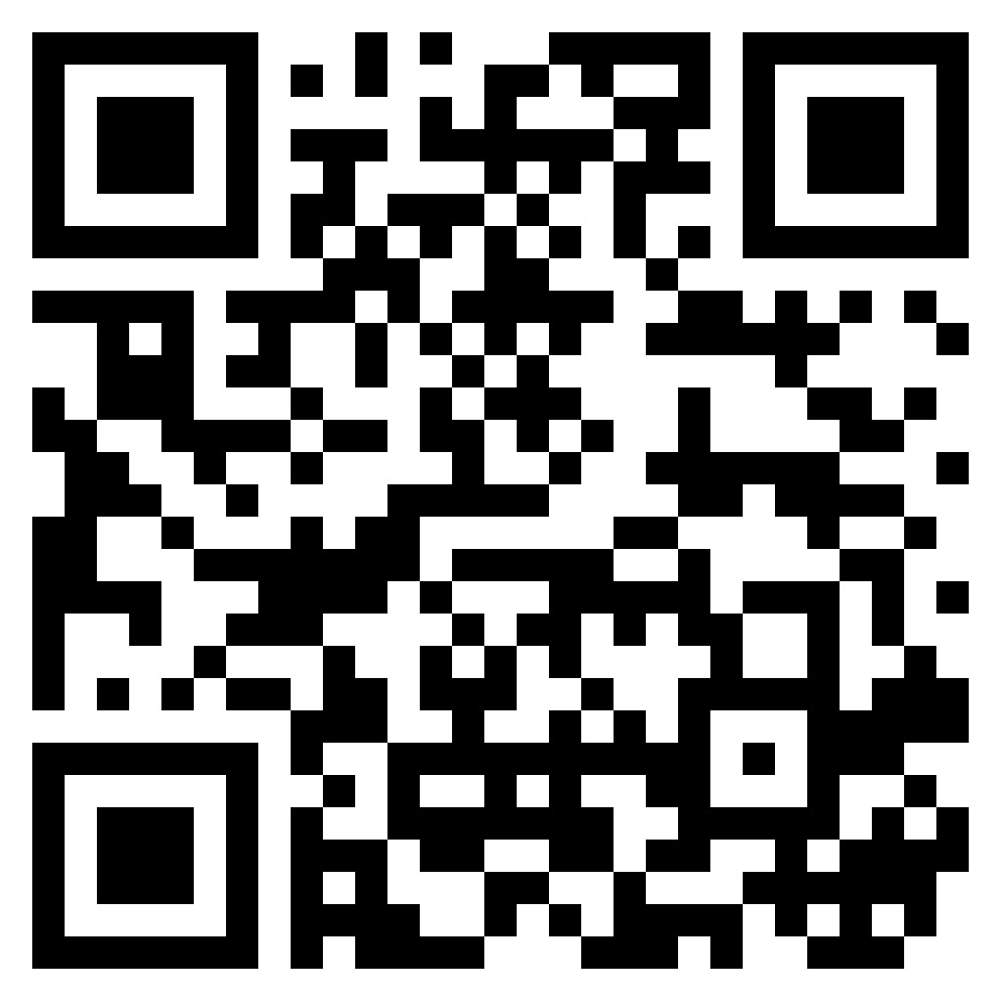
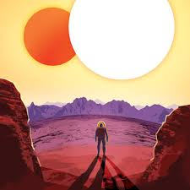
Introduction
Planetary tourism is a great innociative that allows us to experience the vastness of the universe. It opens up new possibilities for exploration and expands our understanding of space. Let’s begin our journey in the space tourism.
Website link: https://spaceappsastronauticx.wordpress.com/

Slide 3

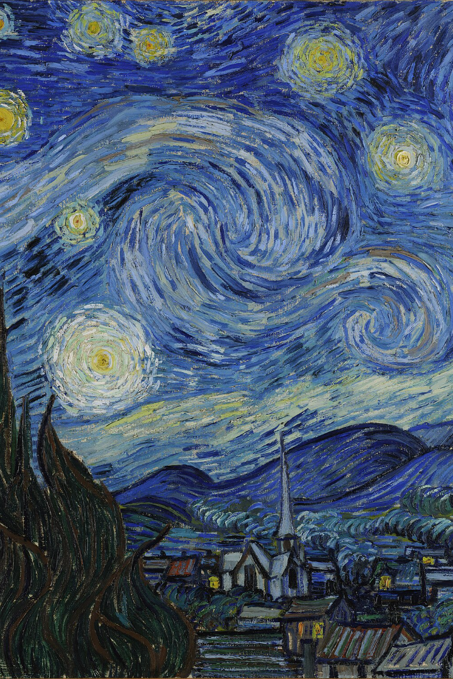
Why it is Important ?
Information or Educational Resource
-> A planetary tourism website can provide comprehensive information about space tourism offerings, including details about space travel experiences, destinations. They also promote STEM (Science, Technology, Engineering, Mathematics) education by providing resources and information about the technology and science involved in space tourism.
Marketing and Promotion
-> A website serves as a powerful marketing tool for the space tourism industry. It can showcase the unique and transformative experiences space tourists can expect, helping to attract a broader customer base.
Inspiration and Aspiration
-> Space tourism websites can inspire people to dream big and aspire to explore the cosmos. They can showcase the human spirit of adventure and the possibilities of space exploration.

Slide 4
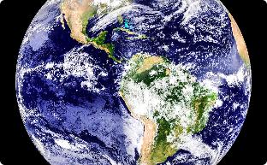

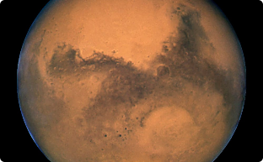
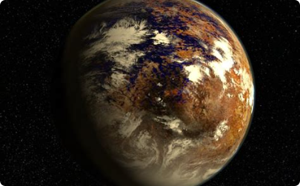
Planetary Destinations
Earth
Moon
Our home planet, filled with diverse landscapes and breathtaking beauty.
A celestial body that has fascinated humans for centuries and holds the key to our space exploration dreams.
Mars
The red planet, with its potential for sustaining life and the possibility of future colonization.
Proxima Centauri B
The closest known exoplanet to Earth, orbiting Proxima Centauri, our nearest stellar neighbor.

Slide 5
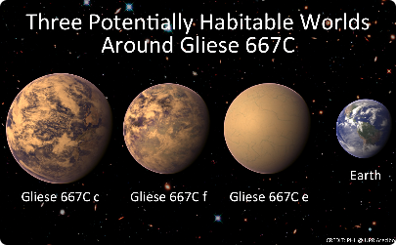
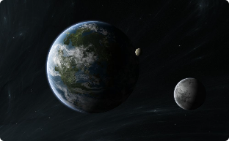
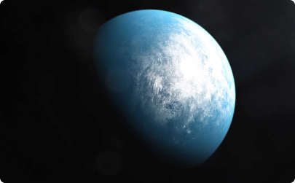
More Planetary Destinations
TOI-700D
Gliese 667 CC
Kepler-452B
A habitable exoplanet, part of a triple star system.
An exoplanet that resembles Earth, located in the habitable zone of a sun-like star.
An exoplanet located in the habitable zone of its star, worth exploring for signs of extraterrestrial life.

Slide 6
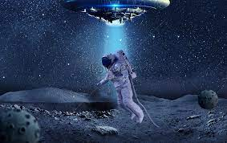
About the Website of Planetary Tourism
In the Website you will be able to explore different planets . You will be naviagated to different plants. You will get to know about various details of planets. It will beenfical for students as well as space aspirants who wants to know more about space. It is an inspirational for the space enthusiast

Slide 7
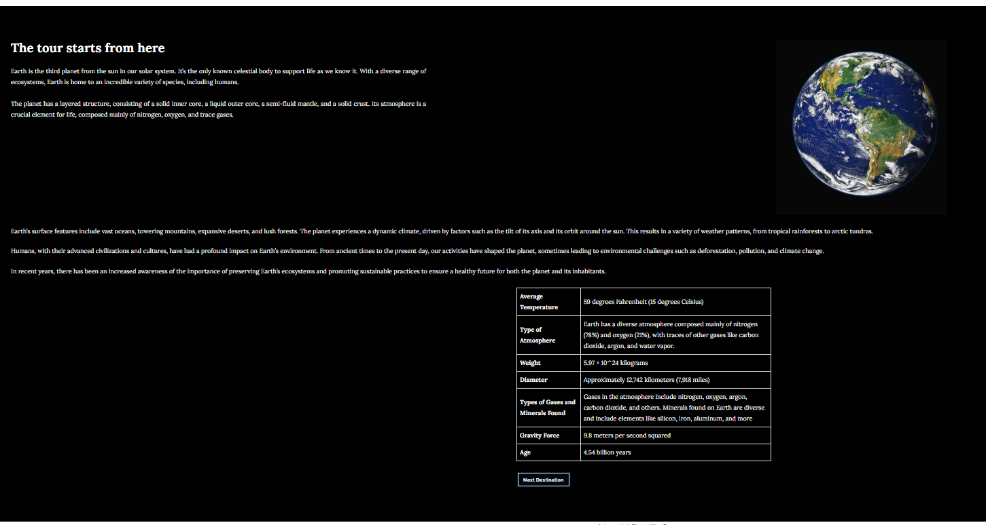
First Destination: Earth

Slide 8
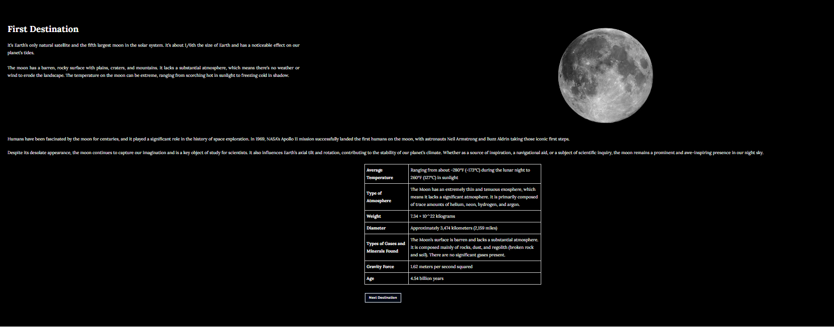
Moon

Slide 9
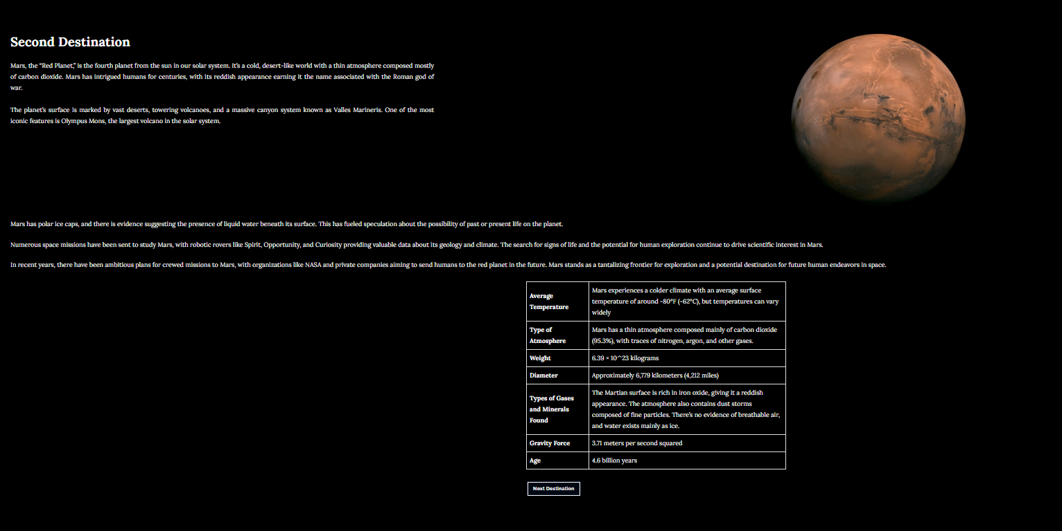
Next Destination: Mars

Slide 10
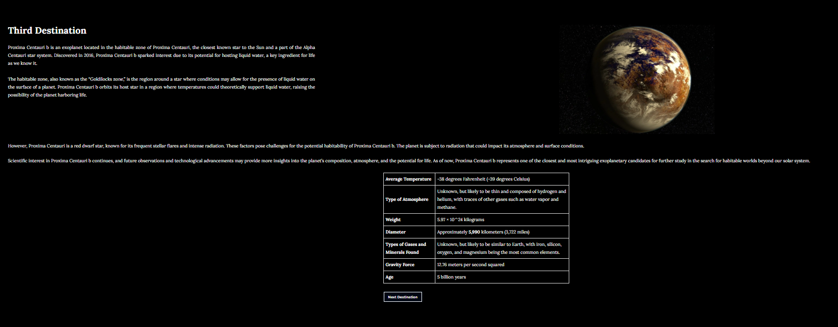
Next Destination: Proxima Centauri B

Slide 11
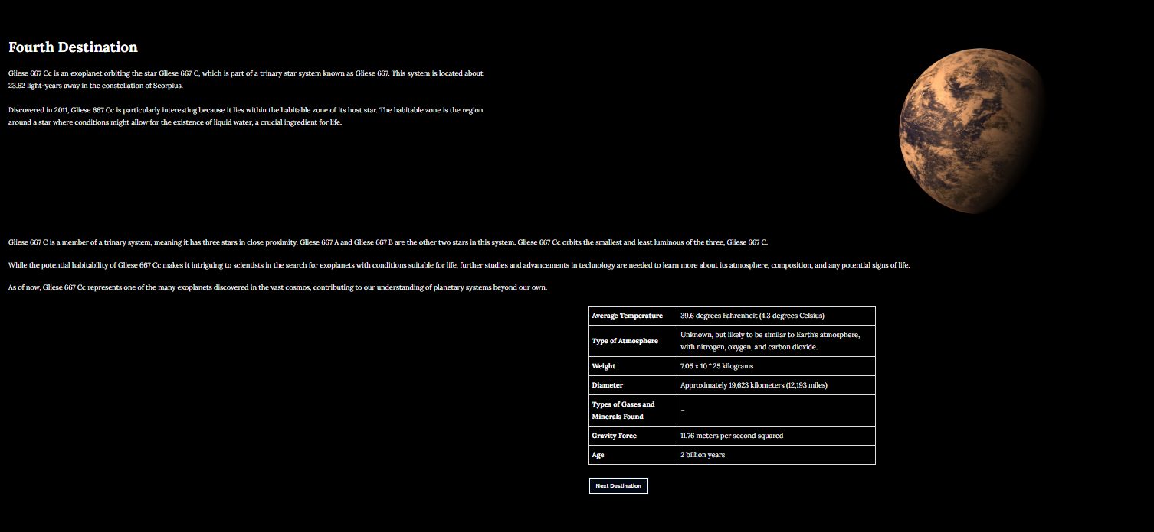
Next Destination: GLIESE 667 CC

Slide 12
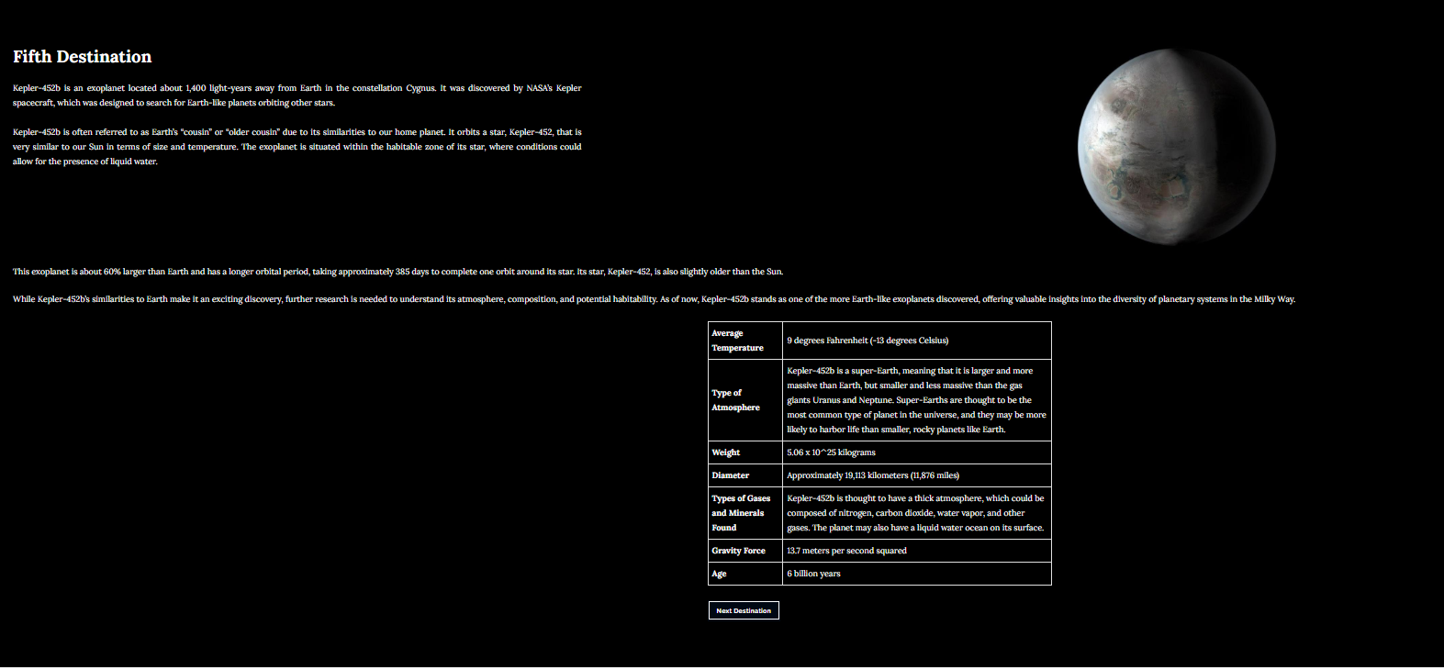
Next Destination: Kepler-452B

Slide 13
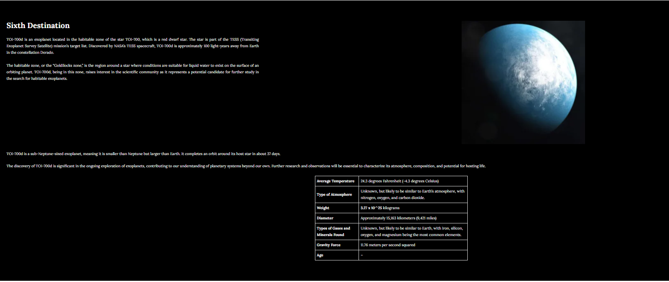
Next Destination: TOI-700D

Slide 14
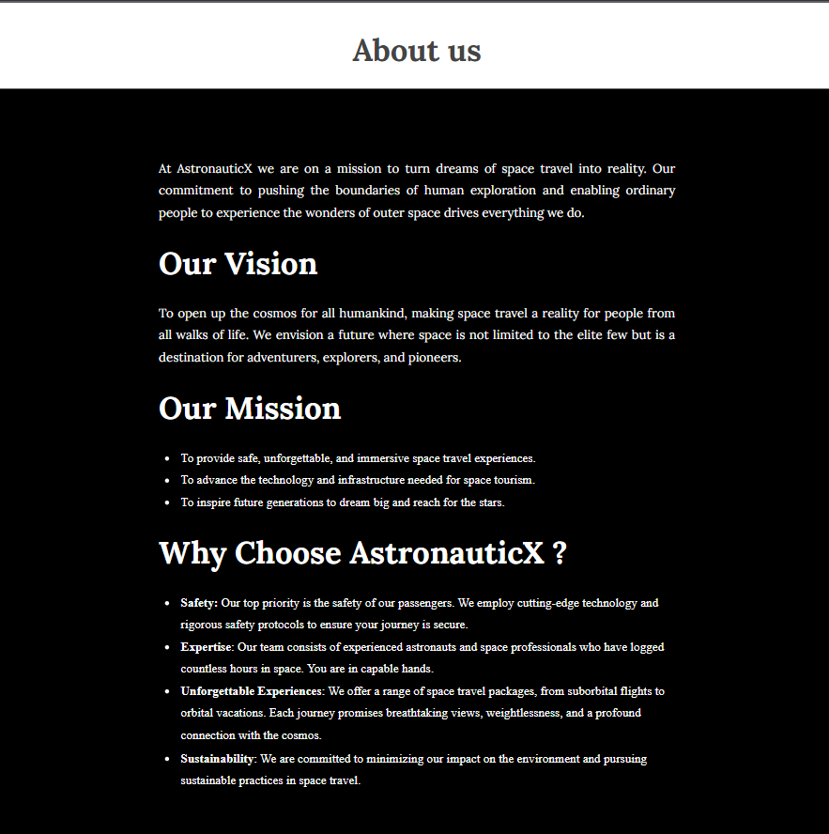
About Us

Slide 15
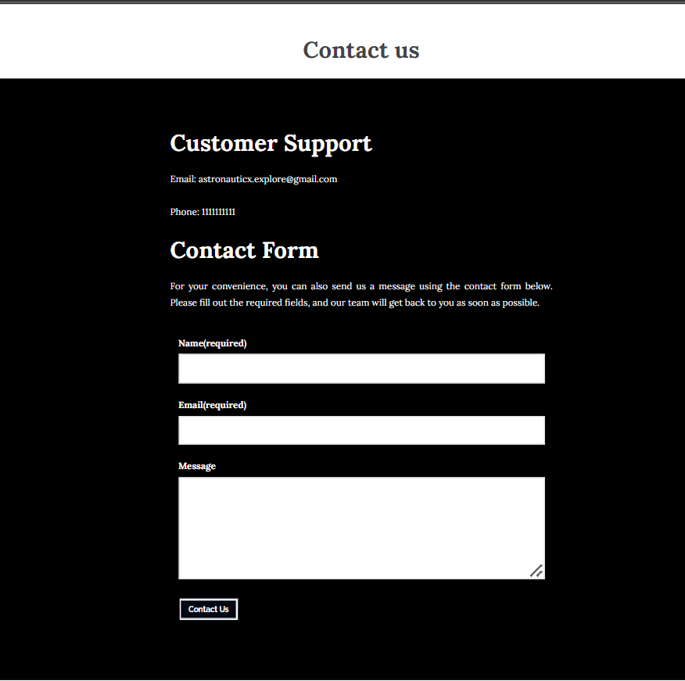
Contact Us

Slide 16


